Slide 1
Traffic Sign Recognition

Slide 2
Introduction
The objective of the project is to identify traffic sign via
camera to inform the driver about it.
The basic concept of this project is :-
To convert the input image to HSV format to extract the binary image.
Remove the noise from binary image using morphological operations.
Then contours are used to segment out the region of interest and further the region is analysed to get the final result.

Slide 3
Literature Survey
For reference purpose we have used following IEEE papers:
A System for Traffic Sign Detection ,Tracking , and Recognition Using Color, Shape and Motion Information (ISSN:1931-0587)
Road Sign Detection and Recognition Based on Support Vector Machines (ISSN:1524-9030)
An Incremental Framework for Video-based Traffic Sign Detection, Tracking and Recognition (ISSN:1524-9050)

Slide 4
Drawbacks:
There were some drawbacks in the above mentioned papers like-

Slide 5
Problem Formulation
There have been so many accidents where the main cause of the accident was that the driver was not paying attention on the traffic sign or didn’t understand it.
By using this system we can alert the driver before hand and avoid such accidents.

Slide 6
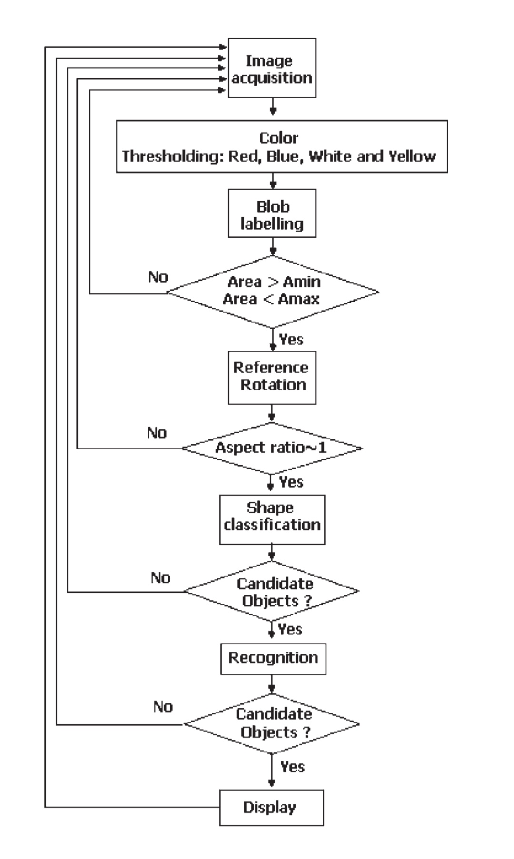
Flow Chart

Slide 7
Requirements
Software Requirements
Python (version>3.0)
OpenCV
Numpy
Imutils
Harware Requirements
PC with webcam or other external camera

Slide 8
Implementation

Slide 9
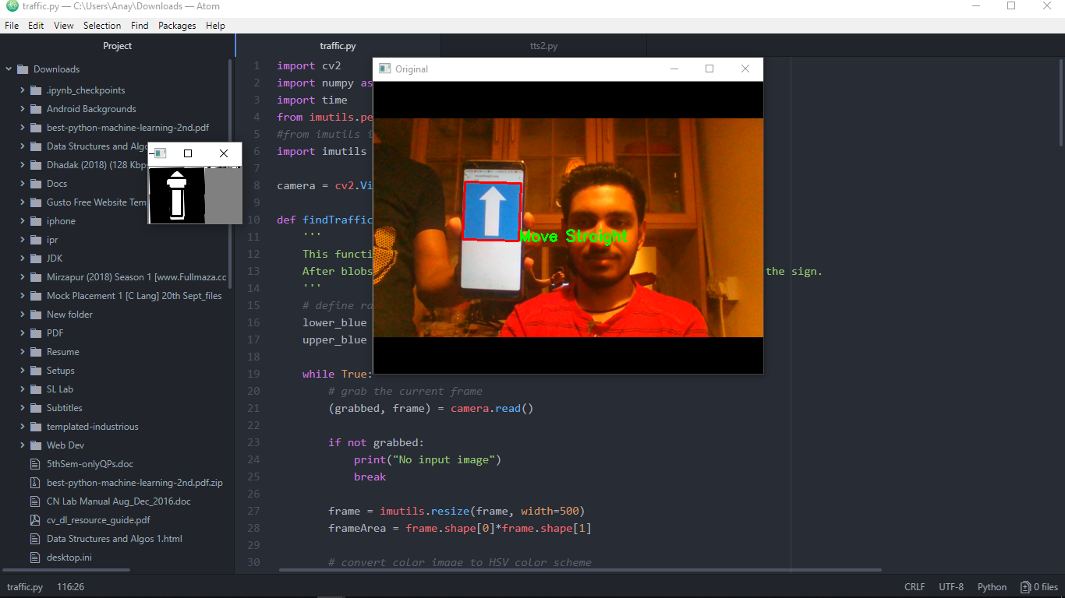

Slide 10
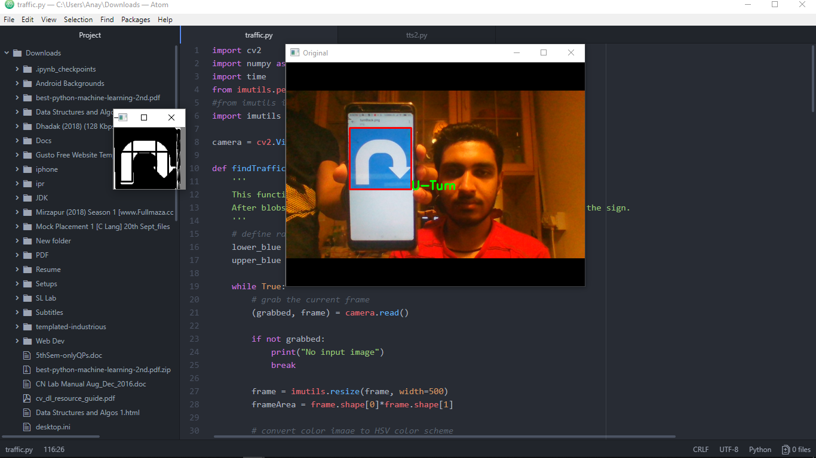

Slide 11
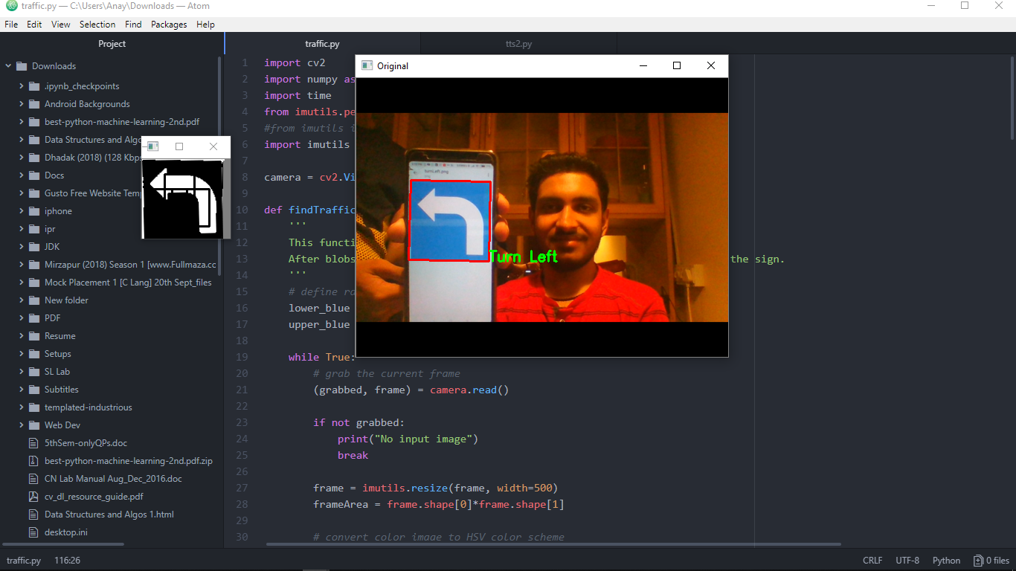

Slide 12


Slide 13
Results
The program is able to detect and recognise traffic signs and display them.

